Slide 1
Stepwise through LTPPBind On-line
2/21/2017

Slide 2
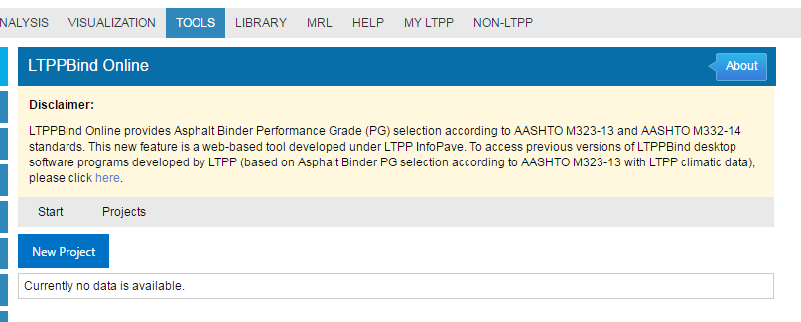
Opening Screen
Click on New Project

Slide 3
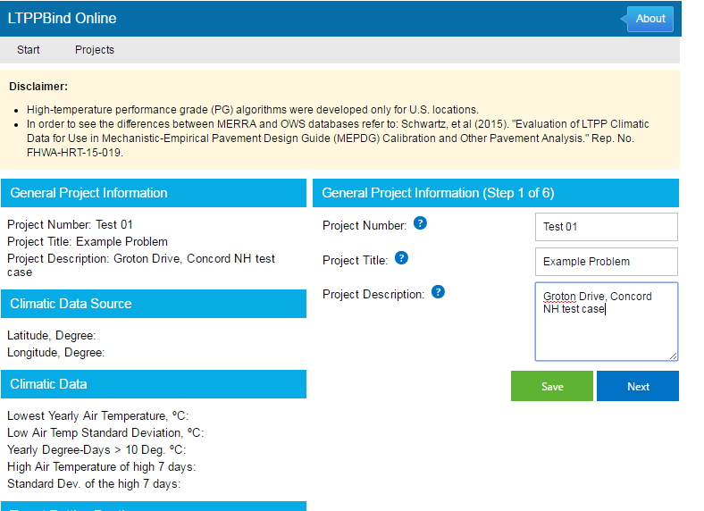
Step 1 – Project Information
Enter Project Number and Project Title that are required
Provide any applicable project description information.
General Project Information on the left will be completed with the information provided.
Click on Next.

Slide 4
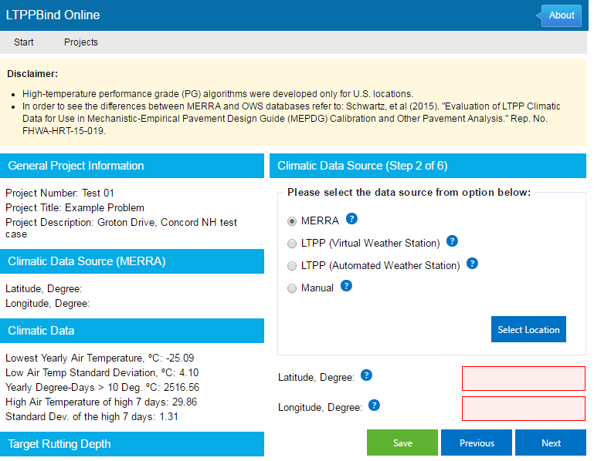
Step 2 – Climatic Data Source
Pick a data source. For this example the MERRA data set will be used. This selection will populate the climatic inputs needed in the step 3 directly.
Click on Select Location -

Slide 5
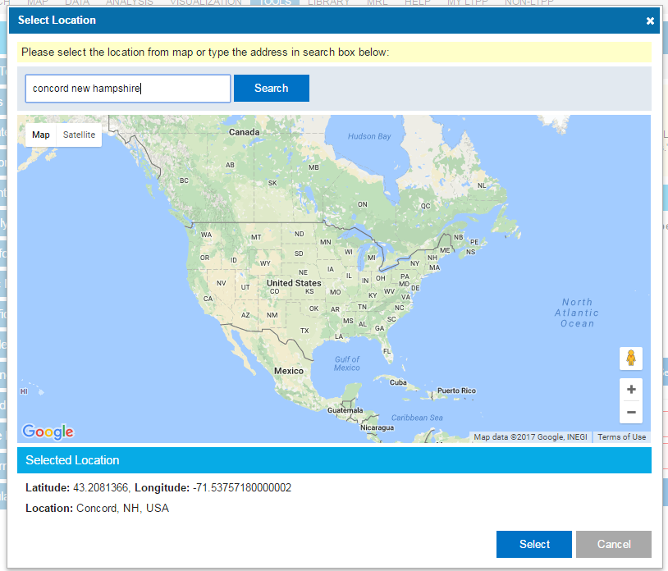
Step 2a – MERRA data selection
Type in the city and state and click on Select. The latitude and longitude will appear.
Using Search will put a pin in the location selected.
An alternative location source can be used to check location.
The coordinates from a Google search for the same city are -
43.2081° N, 71.5376° W
Click on Select.

Slide 6
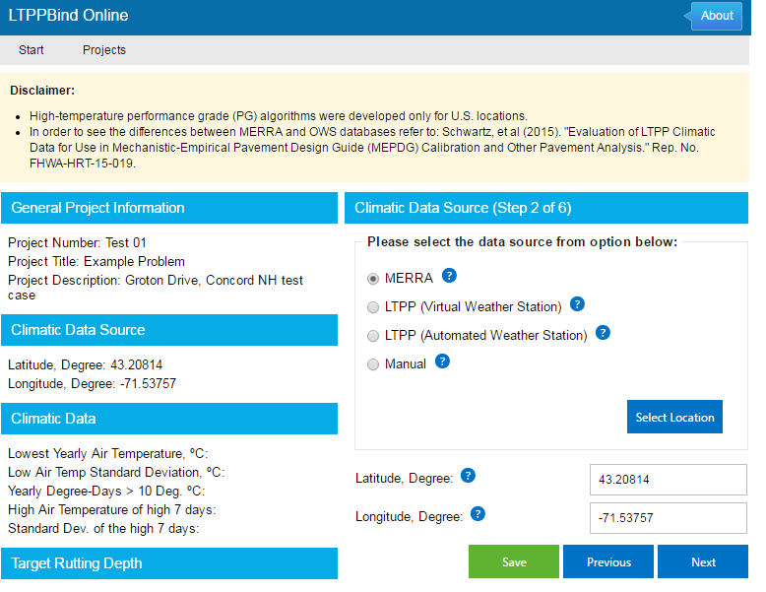
Step 2b – MERRA data entry completed
Click Next.

Slide 7
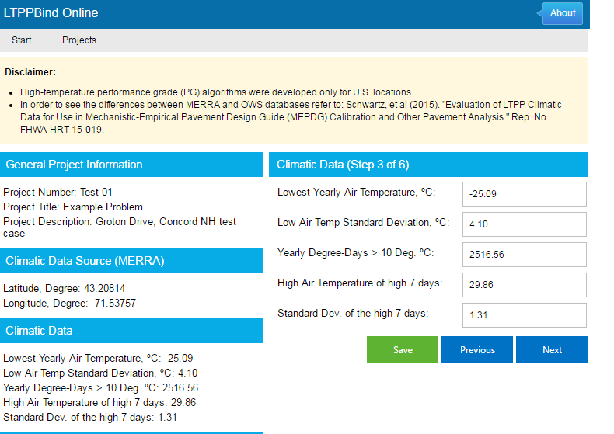
Step 3 – Climatic Data
The variables under Climatic Data have all been populated from the MERRA data set. If Manual had been selected as the climatic data source, these values would have needed to be computed and supplied by the user.
Click Next.

Slide 8
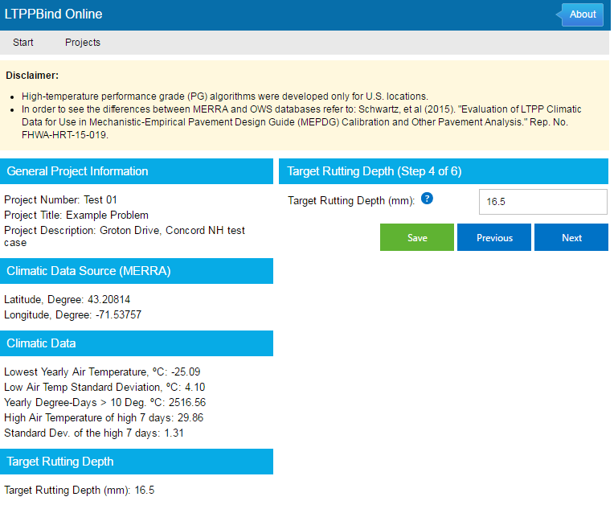
Step 4 – Target rutting depth
The AASHTO 2015 MEPDG Manual of Practice suggested value is used for this example (recommendations are under the ? By the data entry field).
Click Next.

Slide 9
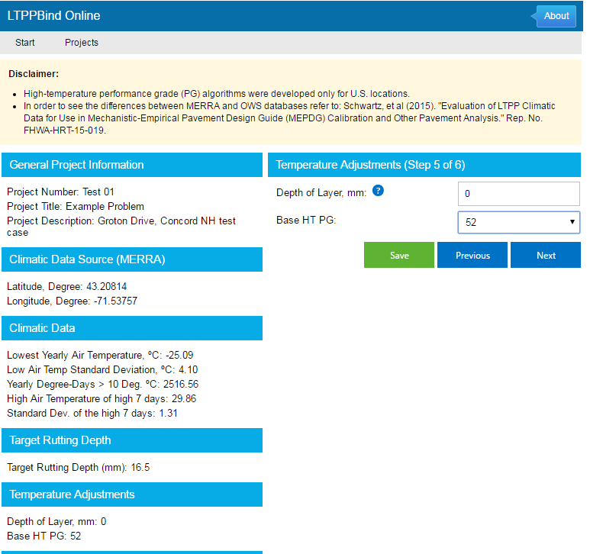
Step 5 – Temperature Adjustments
Assume that no temperature adjustments are required. To know if they are required, the documentation for model development should be consulted.
Details on selection of a Base HT PG value should also be reviewed in the documentation.
Click Next.

Slide 10
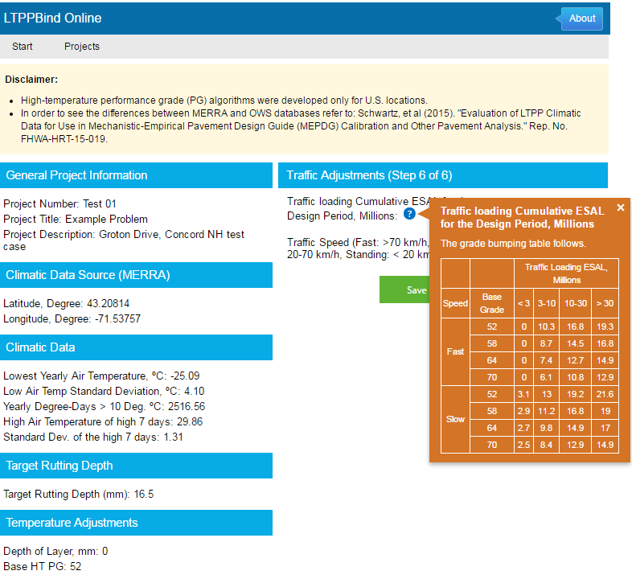
Step 6 – Traffic Adjustments
Groton Drive a local street with an ADT of 300 and 1% trucks will have less than 3 Million ESALs in the design period. (If it is assumed that they are all fully loaded tractor trailers (ESAL per truck ~ 2 with a 20 year design period the estimated ESAL value is 300 * 0.01 * 365 * 20 * 2 or well under a million)
As a local street the traffic will be generally slow (20-70 kmh).
With the Base HT PG assumed for this example (52) the value for traffic loading from the table is 3.1.

Slide 11
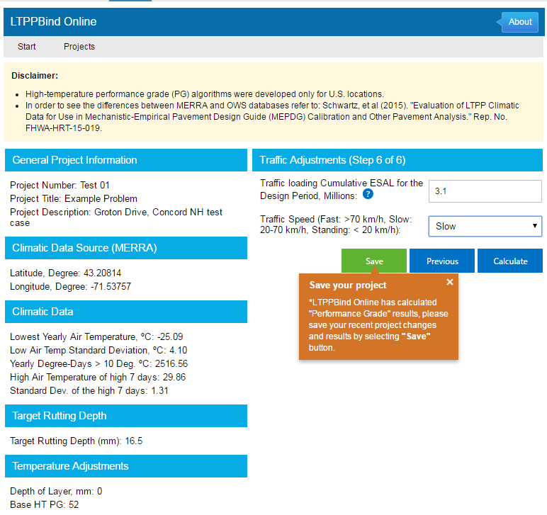
Step 6 – Traffic Adjustments - entered
Completion of analysis.

Slide 12
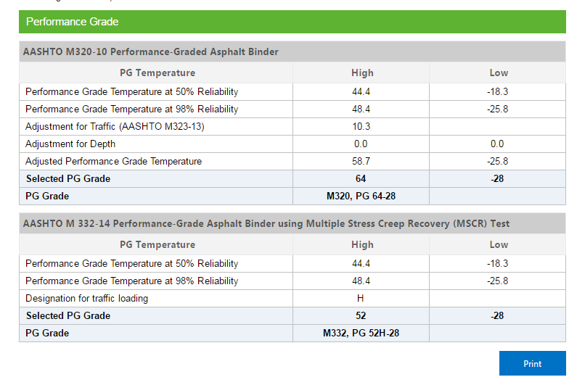
Results
Bottom of the data entry screen in Step 6.

